Slide 1
Youtube ANALYSIS
DATA
Presentation Begins

Slide 2
GROUP MEMBER :
1. ARPITYA KUMAR SINGH
2. ASHISH KUMAR SAHAY
3. ASUTOSH KUMAR SANDAL
4. STHANU PRADHAN

Slide 3
CONTENTS
Youtube Data ANALYSIS
1. Introduction on data.
2. Basic Concepts of big data
3. Problem Statement / Requirements Specifications
4. Implementation
5. Standard Adopted.
6. Conclusion and Future Scope

Slide 4
INTRODUCTION
01
Data ANALYSIS

Slide 5
Introduction on Data
Youtube Data ANALYSIS
Data refers to data that is collected, processed and analyzed to provide insight and information. It is available in many formats, including text, numbers, images, audio and video. In today's digital age, data is generated at an unprecedented rate from many sources, including social media, sensors, mobile devices and the Internet of Things (IoT).

Slide 6
CONCEPTs OF BIG DATA
02
YoutubeData ANALYSIS

Slide 7
Basic Concepts of Big Data
Big data has three basic features
Data Analysis of Youtube
02
01
Data Analysis of Youtube using Power BI
03
YoutubeData ANALYSIS
Marketing Research
Channel Performance Analysis
Volume, speed, diversity
Unstructured data into interactive visualisations

Slide 8
Big data has three basic features:
1. Volume: Big data refers to data that is too large to be processed with normal data processing methods. Data volumes can range from terabytes to petabytes and even exabytes. 2. Speed: Large files are created and processed very quickly. The speed of information refers to the speed at which information is produced, collected and processed. 3. Diversity: Big data, structured data (For example, data in databases), semi-structured data (like data in XML files), and unstructured data (eg., social media data, text data, and multimedia data).
Youtube Data ANALYSIS

Slide 9
Data Analysis of Youtube
Youtube Data ANALYSIS
Marketing Research: Analyzing video and video trends can help generate content ideas and help creators stay ahead of popular content.
Channel Performance Analysis: Analyzing a YouTube channel's performance over time can provide insight into overall growth and help identify areas for content.

Slide 10

Data Analysis of Youtube using Power BI
Youtube Data ANALYSIS
Power BI's user-friendly interface makes it simple for people and businesses to connect to a variety of data sources, clean and transform data, and produce dynamic reports and dashboards.
It is a crucial tool for businesses to analyze their data and make informed decisions because of its potent features like data modeling, advanced analytics, and AI capabilities.

Slide 11
Problem Statement / Requirement Specifications
03
Youtube Data ANALYSIS

Slide 12
Problem Statement
Youtube Data ANALYSIS
This study aims to identify key factors for YouTube channel success in a competitive market. It will evaluate channel effectiveness, suggest improvements for content and engagement, and explore opportunities for monetization, audience growth, and partnerships to boost revenue and brand recognition.

Slide 13
Project Planning
MERCURY
VENUS
Youtube Data ANALYSIS
&
Research questions and the goals of the project.
Collect and analyze information about YouTube metrics such as views, Video etc
PowerBI Data visualization and analytical techniques
insights and conclusions
highlighting key points
Creating a Dashboard on Power BI

Slide 14
Project Analysis
The purpose of the YouTube Channel Analysis project is to identify the most profitable category to create content. The project collected data on the number of views of 1000 channels and analyzed the income of customers using Python scripts to clean and organize files. The team used computational statistics to analyze the data, including mean, median, and standard deviation for each parameter. The team presented their research results to channel owners in a PowerPoint presentation that included visual aids such as charts and graphs.
Youtube Data ANALYSIS

Slide 15
System Design
Youtube Data ANALYSIS
To analyze YouTube channels, various software tools, and datasets are used, such as Google Analytics, YouTube Analytics, Social Blade, and TubeBuddy.
These tools can gather essential information on channel performance, audience characteristics, and engagement metrics.
A typical hardware configuration for analyzing YouTube channels includes a computer with a fast internet connection, a microphone, a camera, and other video production tools.
Additional data storage and backup solutions may be necessary to prevent data loss during the analysis process.

Slide 16
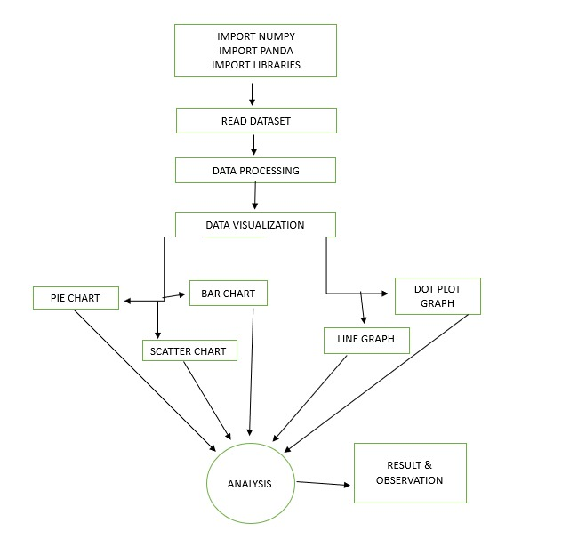
Block Diagram
Youtube Data ANALYSIS

Slide 17
IMPLEMNTATION
04
Youtube Data ANALYSIS

Slide 18
Methodology
Data processing
Data Collection
Youtube Data ANALYSIS
Data standardization
standardize data to ensure data consistency
examination and cleaning of a YouTube channel’s data.
Collection of data set

Slide 19
Data transformation
Data cleaning
Youtube Data ANALYSIS
improve the data's suitability
eliminating any duplicate entries, fixing mistakes
Data Visualization
Clean data can be visualized

Slide 20
Testing OR Verification Plan
Pie Chart Visualization
Bar Chart Visualization
Scatter Plot Visualization
Youtube Data ANALYSIS

Slide 21

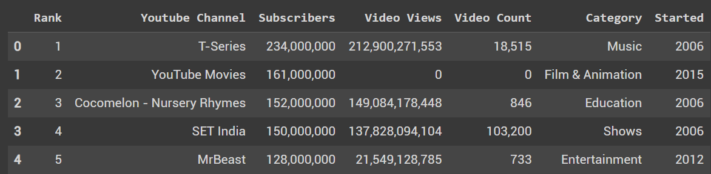
Result Analysis
Youtube Data ANALYSIS

Slide 22
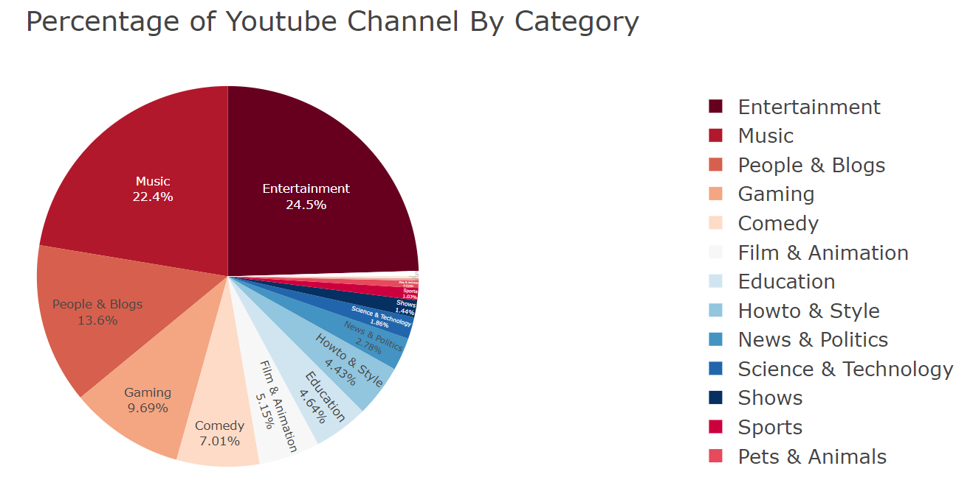
Percentage of youtube channel by categories
Youtube Data ANALYSIS

Slide 23
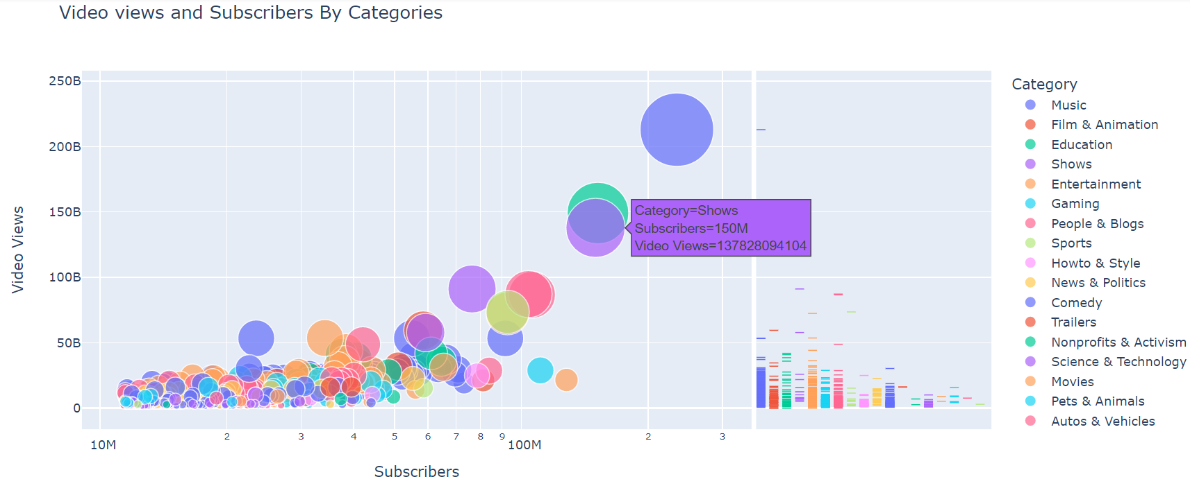
Video views and subscribers by categories
Youtube Data ANALYSIS

Slide 24
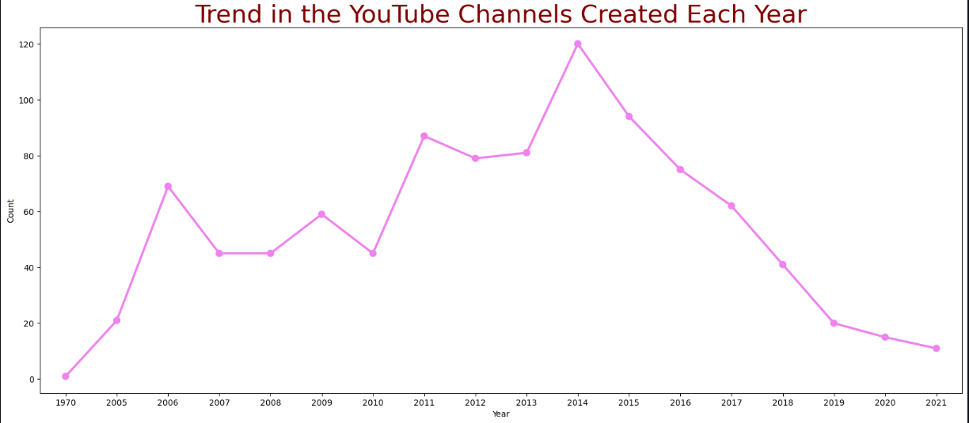
Trends in youtube channel created each year
Youtube Data ANALYSIS

Slide 25
Trends in youtube channel created each year
Youtube Data ANALYSIS

Slide 26
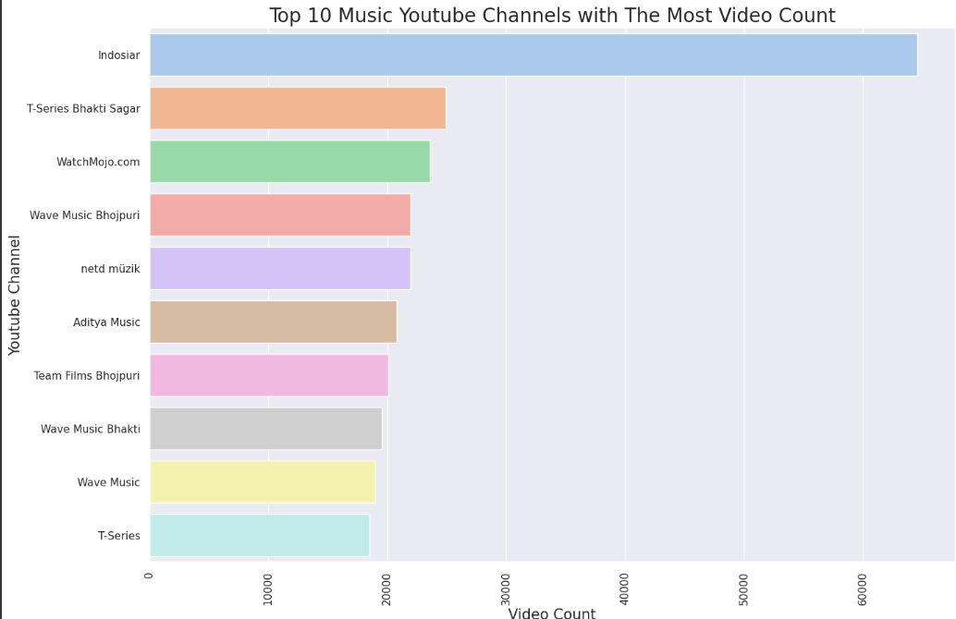
Top 10 Music Youtube Channels with The Most Video Count
Youtube Data ANALYSIS

Slide 27
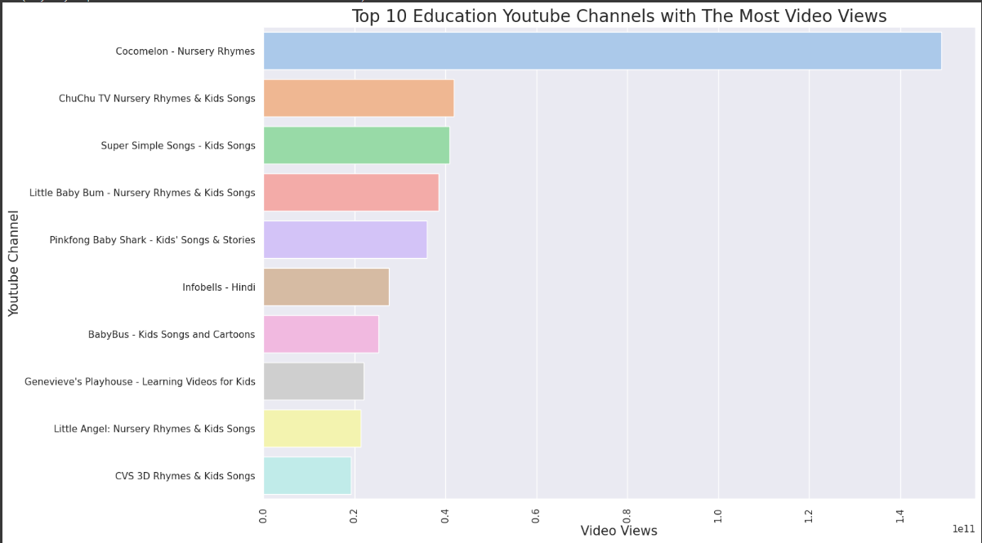
Top 10 Education Youtube Channels with The Most Video Views
Youtube Data ANALYSIS

Slide 28
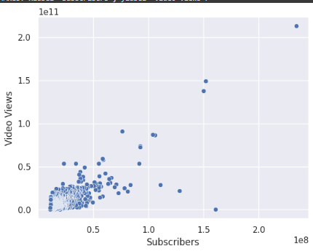
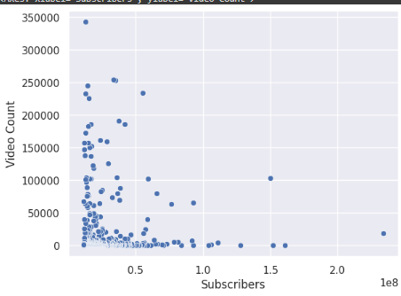
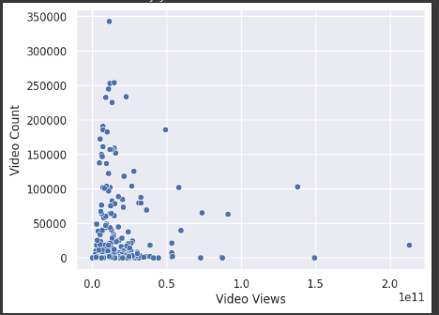
Corelation between variable
Youtube Data ANALYSIS

Slide 29
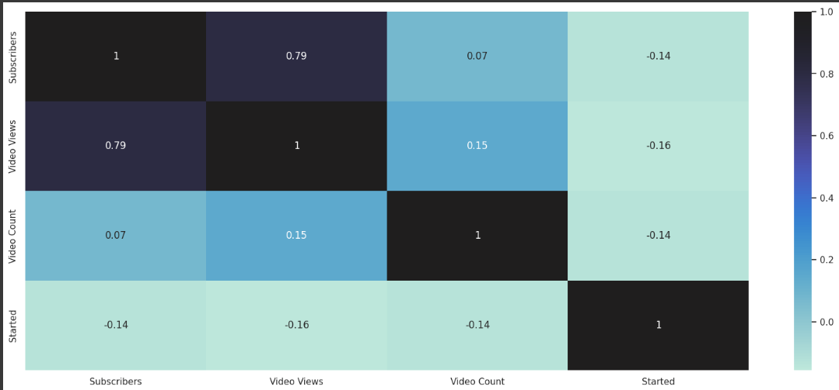
The heat map explains the correlation
Youtube Data ANALYSIS

Slide 30
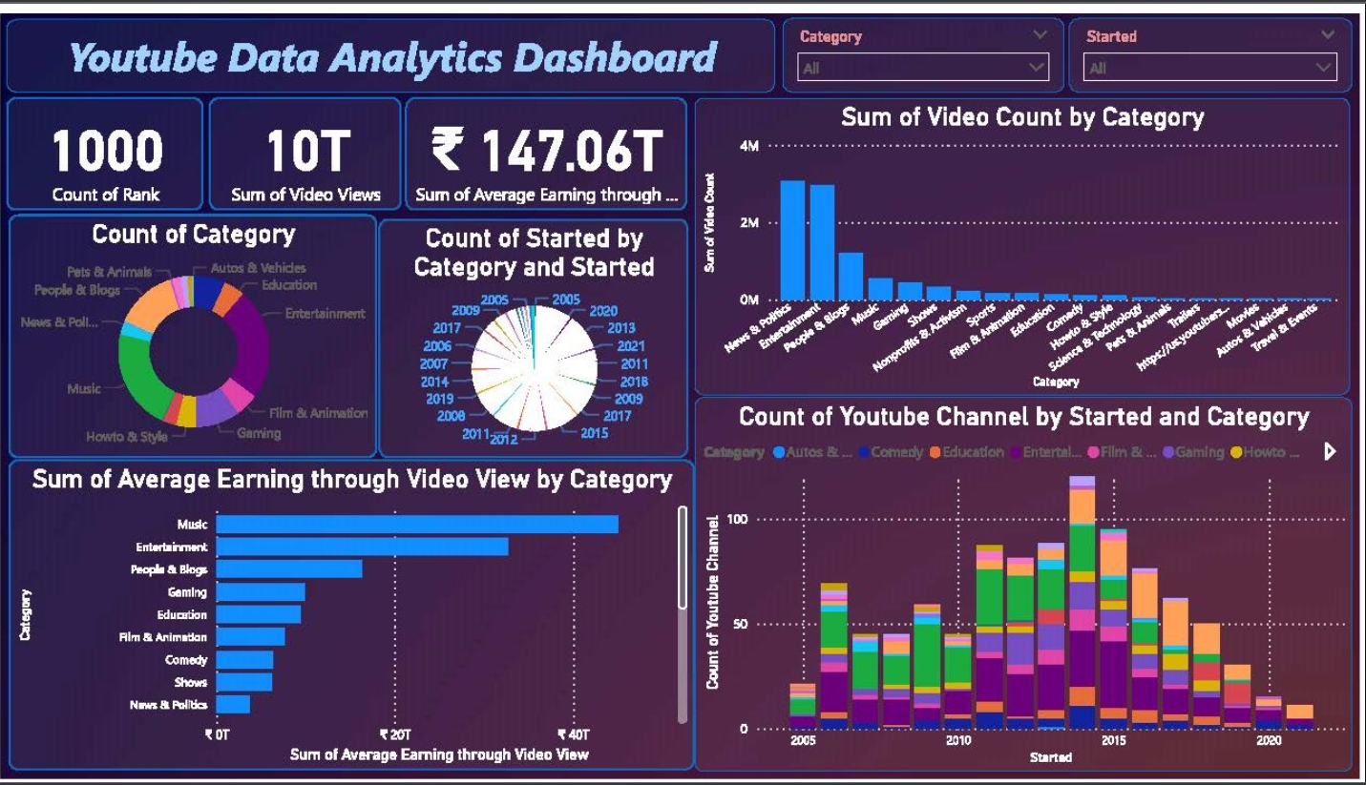
PowerBI DASHBOARD
Youtube Data ANALYSIS

Slide 31
STANDARDS
05
Youtube Data ANALYSIS

Slide 32
Design Standards
Testing Standards
Coding Standards
Youtube Data ANALYSIS
he code's objective is to examine the top-subscribed YouTube channels and their attributes,
used standard that offers a structure for recording the testing process
Four spaces are used in the code to indicate the indentation.

Slide 33
CONCLUSION FUTURE SCOPE
Youtube Data ANALYSIS
05

Slide 34
CONCLUSION
Youtube Data ANALYSIS
In summary, the YouTube Channel Analysis project achieved its goal of understanding the performance of specific channels over the course of 10 years. By collecting data on views and subscribers, the team can identify key insights and generate revenue for specific YouTube channels.
This project highlights the importance of a good data collection, cleaning and analysis process in making recommendations to stakeholders. The use of descriptive statistics and regression analysis provides a clear picture of the channel's performance and identifies the relationship between different indicators.

Slide 35
FUTURE SCOPE
Youtube Data ANALYSIS
There are several opportunities in the future for the YouTube Channel Analysis project to improve its results, for example:
Provide more information
Build a Dashboard
Test content strategies
Advanced analytics techniques
Comparison with competitors
Automated data collection

Slide 36



THANKS!
Youtube Data ANALYSIS

